Slide 1

Week 4
Fundamental Algorithms

Slide 2
Agenda
Machine Learning
Scikit learn
Decision Tree
Evaluation
Random Forest

Slide 3
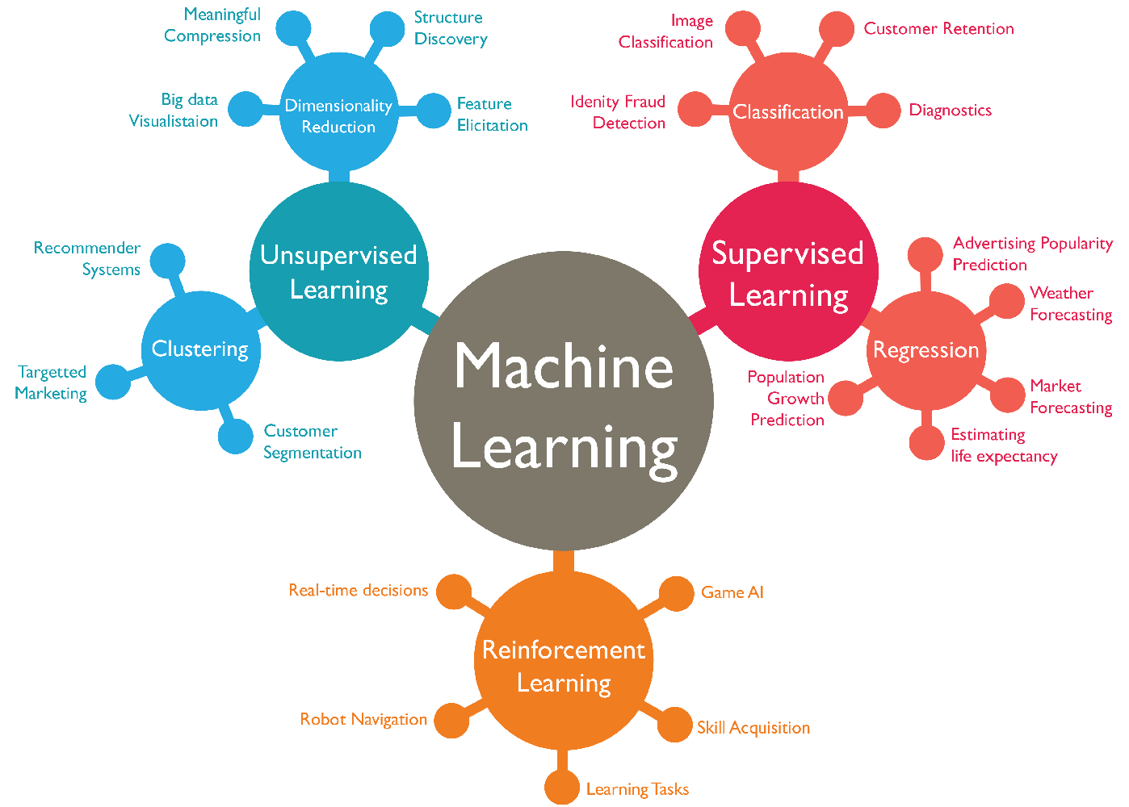

Slide 4
Supervised Learning
In supervised learning, we train the machine using data which is well "labeled." It means data is already tagged with the correct answer.
A supervised learning algorithm learns from labeled training data, then helps you to predict outcomes for new unlabled data.

Slide 5
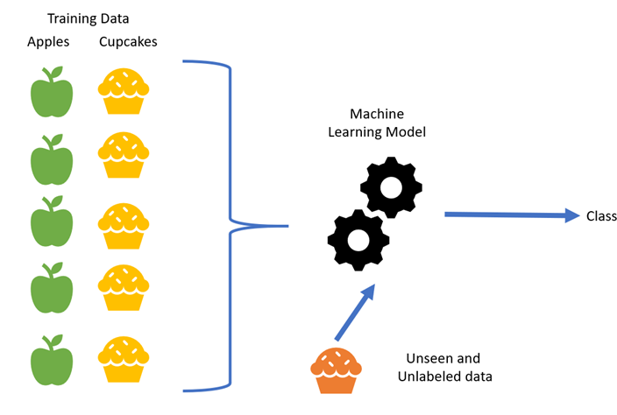

Slide 6
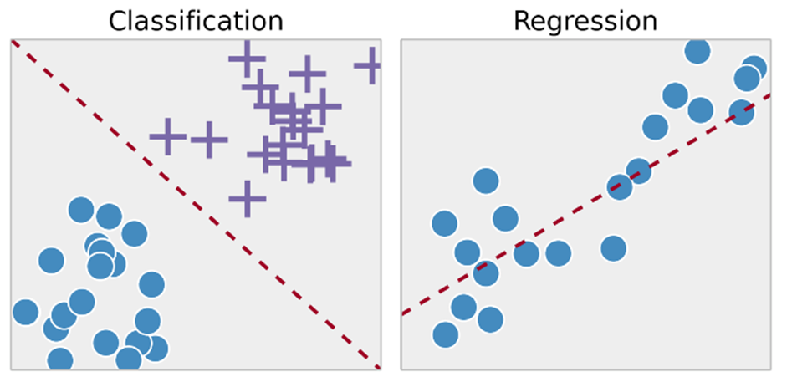

Slide 7
Unsupervised Learning
Unsupervised learning is a machine learning technique, where you do not need to provide lables to the model. Instead, we need to allow the model to work on its own to discover information.

Slide 8
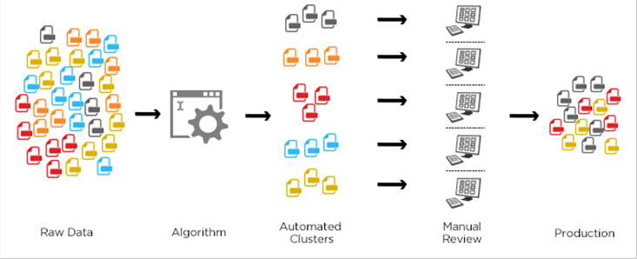

Slide 9
Reinforcement Learning
Reinforcement learning is all about making decisions sequentially. In simple words we can say that the output depends on the state of the current input and the next input depends on the output of the previous input.
In Supervised learning the decision is made on the initial input or the input given at the start.
In Reinforcement learning decision is dependent, So we give labels to sequences of dependent decisions

Slide 10


Slide 11
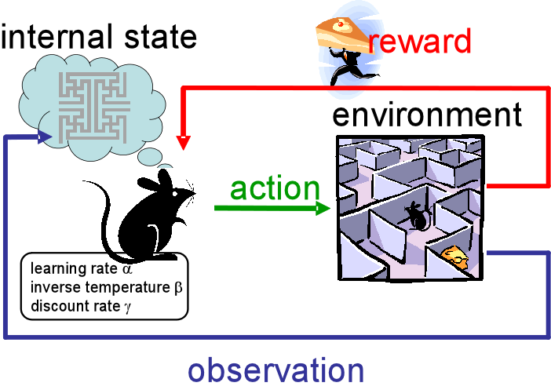

Slide 12


Slide 13
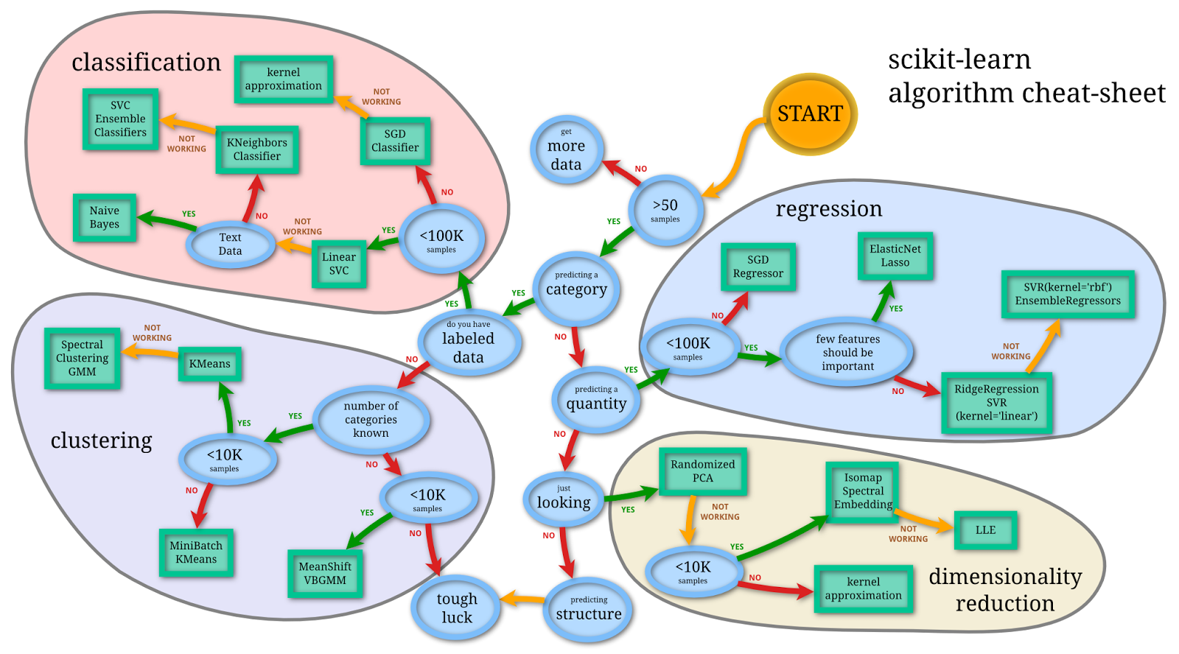

Slide 14



Slide 15
Queen Elizabeth

Slide 16
Female?
True
False
Queen?
True
False
Elisabeth

Slide 17
Does this person eats Avocados?
millennial?
True
False
Yes
No

Slide 18
Does this person own Real Estate?
millennial?
True
False
No
Income >50k
Yes
No

Slide 19
How can we get a decision tree from this?
Millennial? | Income >50k | Eats Avocados? | Owns Real Estate
No | No | No | No
Yes | Yes | Yes | Yes
Yes | Yes | No | No
Yes | No | ??? | Yes
etc | etc | etc | etc

Slide 20
Input
Output
Millennial? | Income >50k | Eats Avocados? | Owns Real Estate
No | No | No | No
Yes | Yes | Yes | Yes
Yes | Yes | No | No
Yes | No | No | Yes
etc | etc | etc | etc

Slide 22
Is Millennial?

Slide 23
Income >50k

Slide 24
Avocados?

Slide 25


????

Slide 26
Step 1 Identify which Feature separates the data the best.

Slide 27
Millennial | Owns Real Estate
No | No
Yes | Yes
Yes | No
Yes | Yes
etc | etc
millennial?
Yes
No
Owns Real Estate
Yes No 0 0
Owns Real Estate
Yes No 0 0

Slide 28
Millennial | Owns Real Estate
No | No
Yes | Yes
Yes | No
Yes | Yes
etc | etc
millennial?
Yes
No
Owns Real Estate
Yes No 0 0
Owns Real Estate
Yes No 0 1

Slide 29
Millennial | Owns Real Estate
No | No
Yes | Yes
Yes | No
Yes | Yes
etc | etc
millennial?
Yes
No
Owns Real Estate
Yes No 1 0
Owns Real Estate
Yes No 0 1

Slide 30
Millennial | Owns Real Estate
No | No
Yes | Yes
Yes | No
Yes | Yes
etc | etc
millennial?
Yes
No
Owns Real Estate
Yes No 1 1
Owns Real Estate
Yes No 0 1

Slide 31
Millennial | Owns Real Estate
No | No
Yes | Yes
Yes | No
Yes | Yes
etc | etc
millennial?
Yes
No
Owns Real Estate
Yes No 34 125
Owns Real Estate
Yes No 105 39
Not bad, but not Perfect.

Slide 32
millennial?
millennial?
Yes
No
Yes
No
Owns Real Estate
Yes No 34 125
Owns Real Estate
Yes No 105 39
Owns Real Estate
Yes No 139 0
Owns Real Estate
Yes No 0 73
Not bad
Perfect

Slide 33
millennial?
millennial?
Yes
No
Yes
No
Owns Real Estate
Yes No 34 125
Owns Real Estate
Yes No 105 39
Owns Real Estate
Yes No 139 0
Owns Real Estate
Yes No 0 73
Not bad
Perfect

Slide 34
You don’t have to be perfect, just better than your competitors.

Slide 35
You don’t have to be perfect, just better than your competitors.
-Queen Elizabeth II

Slide 36
Income >50
Yes
No
Owns Real Estate
Yes No 34 125
Owns Real Estate
Yes No 37 127
Eats Avocados?
Yes
No
Owns Real Estate
Yes No 45 129
Owns Real Estate
Yes No 92 31

Slide 37
None of the features separates the data perfectly. These are all considered “impure”.

Slide 38
GINI Impurity
1 - (the probability of “Yes”)² - (the probability of “No”)²
0 means the data is not impure
Going towards 1 is going to be more impure

Slide 39
millennial?
Yes
No
Owns Real Estate
Yes No 34 125
Owns Real Estate
Yes No 105 39

Slide 40
millennial?
Yes
No
Owns Real Estate
Yes No 34 125
Owns Real Estate
Yes No 105 39
Let’s calculate the Impurity of the left leaf

Slide 41
Owns Real Estate
Yes No 34 125
=1 - (the probability of “Yes”)² - (the probability of “No”)²

Slide 42
Owns Real Estate
Yes No 34 125
=1 - (the probability of “Yes”)² - (the probability of “No”)²
=1 - (34 / (34+125) )² - (125/(34+125)²

Slide 43
Owns Real Estate
Yes No 34 125
=1 - (the probability of “Yes”)² - (the probability of “No”)²
=1 - (34 / (34+125) )² - (125/(34+125)²
=0.336

Slide 44
Quiz:
Owns Real Estate
Yes No 105 39
=1 - (105 / (39+105) )² - (39/(105+39)²
=0.395

Slide 45
GINI Impurity for millennial?
millennial?
Yes
No
Owns Real Estate
Yes No 34 125
Owns Real Estate
Yes No 105 39
Gini =0.336
Gini =0.395

Slide 46
millennial?
Yes
No
Owns Real Estate
Yes No 34 125
Owns Real Estate
Yes No 105 39
Gini =0.336
Gini =0.395
GINI Impurity for millennial = weighted Average of Ginie Impurities for the nodes

Slide 47
millennial?
Yes
No
Owns Real Estate
Yes No 34 125
Owns Real Estate
Yes No 105 39
Gini =0.336
Gini =0.395
= (159/(144+159)*0.336 + (144/(144+159)*0.395
= 0.364
159 = total number of the left leaf
144+159 total number (of rows)

Slide 48
Gini impurity Leaderboard
1. Income >50k - 0.360 2. Millennial - 0.364 3. Avocados - 0.381

Slide 49
Gini impurity Leaderboard
Income >50k
1. Income >50k - 0.360 2. Millennial - 0.364 3. Avocados - 0.381

Slide 50
Gini impurity Leaderboard
Income >50k
1. Income >50k - 0.360 2. Millennial - 0.364 3. Avocados - 0.381

Slide 51
Income >50
Yes
No
Owns Real Estate
Yes No 34 125
Owns Real Estate
Yes No 37 127

Slide 52
Income >50
Income >50
Yes
No
Owns Real Estate
Yes No 37 137
Owns Real Estate
Yes No 100 33
37/127
100/33

Slide 53
Income >50
37/127
100/33
Does “Avocados” or “Millenials” separates the remaining data the best?

Slide 54
Calculate GINI for the remaining Data!
37/127
37/127
Millennial
Millennial
Yes
No
Yes
No
Owns Real Estate
Yes No 98 13
Owns Real Estate
Yes No 29 24
Owns Real Estate
Yes No 25 24
Owns Real Estate
Yes No 102 13

Slide 55
Gini = 0.3
Gini = 0.29
37/127
37/127
Millennial
Avocado
Yes
No
Yes
No
Owns Real Estate
Yes No 98 13
Owns Real Estate
Yes No 29 24
Owns Real Estate
Yes No 25 24
Owns Real Estate
Yes No 102 13

Slide 56
Income >50
Avocado
100/33

Slide 57
Income >50
Avocado
100/33
Repeat until GINI Impurity is 0
or no more features left.

Slide 58
What about numerical features?

Slide 59
Current Debt | Owns Real Estate
2000€ | No
1500€ | Yes
1000€ | No
2500€ | Yes
etc | etc

Slide 60
Step 1
Sort rows ascending
Current Debt | Owns Real Estate
1000€ | No
1500€ | Yes
2000€ | No
2500€ | Yes
etc | etc

Slide 61
Step 2
Calculate mean between rows
Current Debt | Owns Real Estate
1000€ | No
1500€ | Yes
2000€ | No
2500€ | Yes
etc | etc
1250
1750
2250

Slide 62
Step 3
Calculate the Gini Impurity for every
mean value
Current Debt | Owns Real Estate
1000€ | No
1500€ | Yes
2000€ | No
2500€ | Yes
etc | etc
1250
GINI Impurity?
1750
GINI Impurity?
2250
GINI Impurity?

Slide 63
Step 3
Calculate the Gini Impurity for every
mean value
Current Debt | Owns Real Estate
1000€ | No
1500€ | Yes
2000€ | No
2500€ | Yes
etc | etc
Debt < 1250
1250
Yes
No
1750
2250
Owns Real Estate
Yes No 34 125
Owns Real Estate
Yes No 105 39

Slide 64
Step 3
Calculate the Gini Impurity for every
mean value
Current Debt | Owns Real Estate
1000€ | No
1500€ | Yes
2000€ | No
2500€ | Yes
etc | etc
Debt < 1250
1250
Yes
No
1750
2250
Owns Real Estate
Yes No 34 125
Owns Real Estate
Yes No 105 39
GINI Impurity = 0.367

Slide 65
Step 3
Calculate the Gini Impurity for every
mean value
Current Debt | Owns Real Estate
1000€ | No
1500€ | Yes
2000€ | No
2500€ | Yes
etc | etc
Debt < 1250
1250
GINI = 0.367
Yes
No
1750
2250
Owns Real Estate
Yes No 34 125
Owns Real Estate
Yes No 105 39
GINI Impurity = 0.367

Slide 66
Step 4
Select the one with the lowest GINI Impurity
Current Debt | Owns Real Estate
1000€ | No
1500€ | Yes
2000€ | No
2500€ | Yes
etc | etc
1250
GINI = 0.367
1750
GINI = 0.204
2250
GINI = 0.389

Slide 67
Step 4
Select the one with the lowest GINI Impurity
Current Debt | Owns Real Estate
1000€ | No
1500€ | Yes
2000€ | No
2500€ | Yes
etc | etc
1250
GINI = 0.367
1750
GINI = 0.204
2250
GINI = 0.389

Slide 69
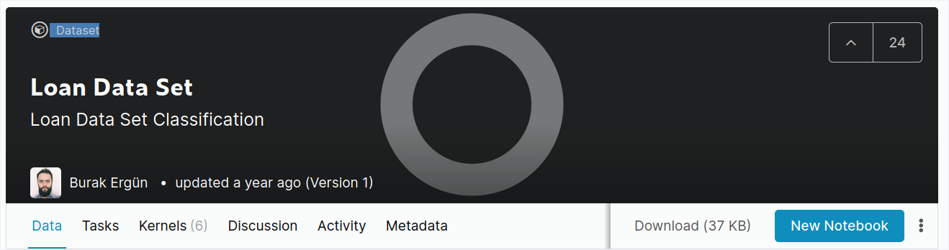

Slide 70
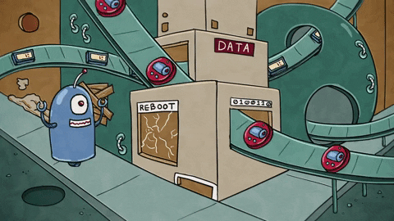

Slide 71
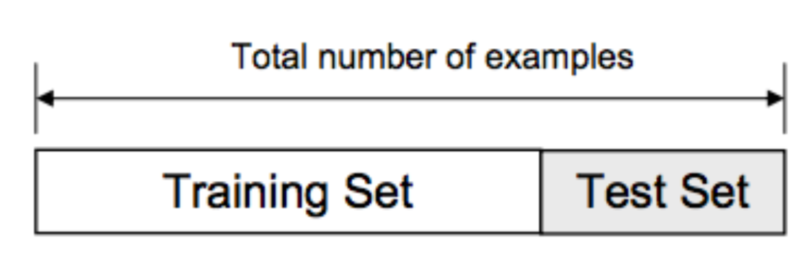
Train/Test Split

Slide 72
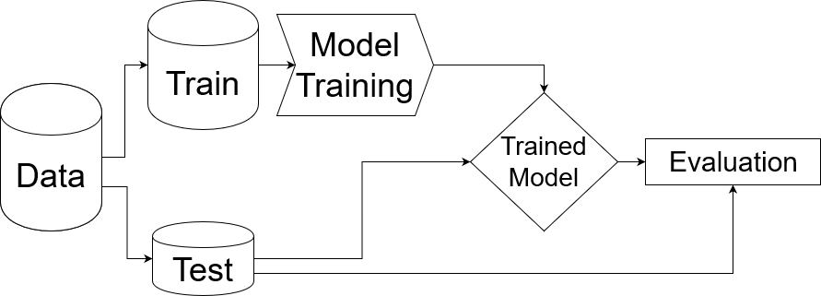

Slide 73
Evaluating Results
Prediction Label | Test Label
1 | 0
1 | 1
0 | 1
0 | 0

Slide 74
Evaluating Results
Prediction Label | Test Label
1 | 0 | False Positive
1 | 1
0 | 1
0 | 0

Slide 75
Evaluating Results
Prediction Label | Test Label
1 | 0 | False Positive
1 | 1 | True Positive
0 | 1
0 | 0

Slide 76
Evaluating Results
Prediction Label | Test Label
1 | 0 | False Positive
1 | 1 | True Positive
0 | 1 | False Negative
0 | 0

Slide 77
Evaluating Results
Prediction Label | Test Label
1 | 0 | False Positive
1 | 1 | True Positive
0 | 1 | False Negative
0 | 0 | True Negative

Slide 78
Confusion Matrix
True Positive | False Positive
False Negative | True Negative
Accuracy is high when green diagonal values are high.

Slide 79
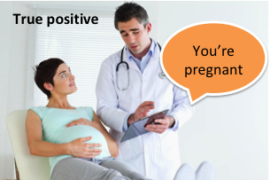
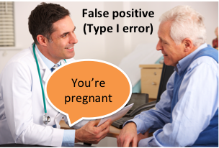
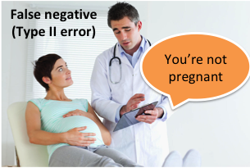
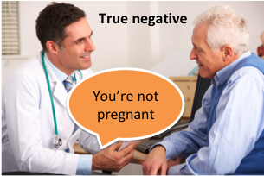

Slide 80
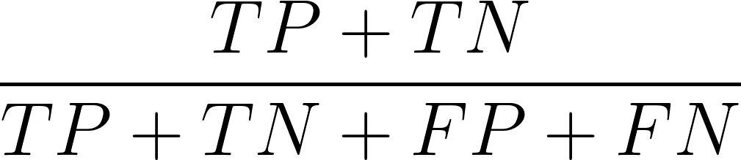
Accuracy

Slide 81
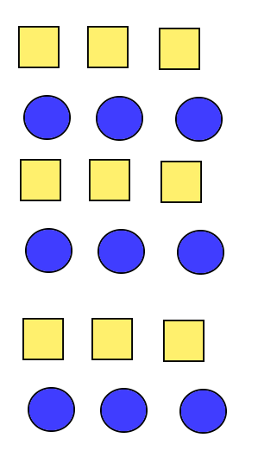
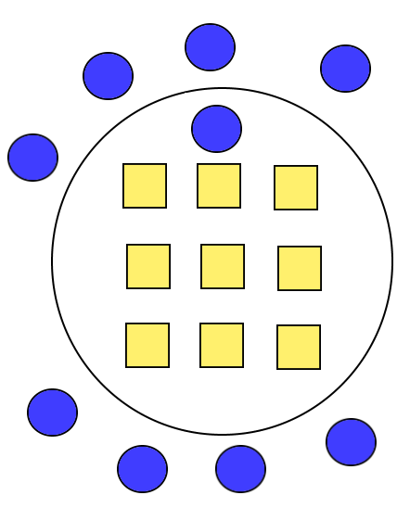
High Accuracy

Slide 82
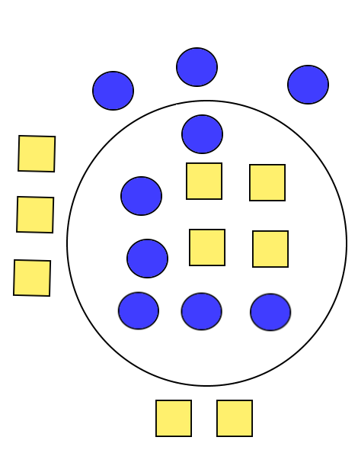
Low Accuracy

Slide 83
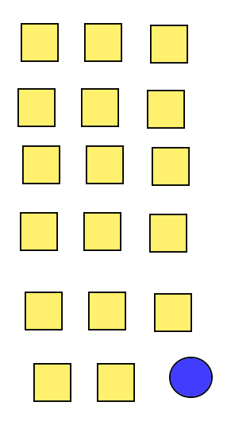
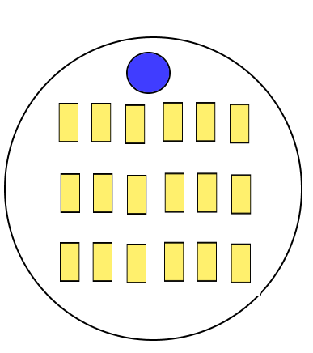
Misleading Accuracy

Slide 84
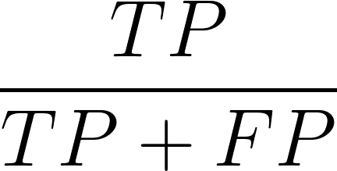
Precision

Slide 85
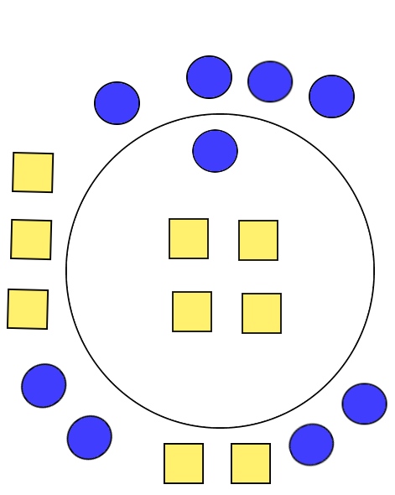
High Precision

Slide 86
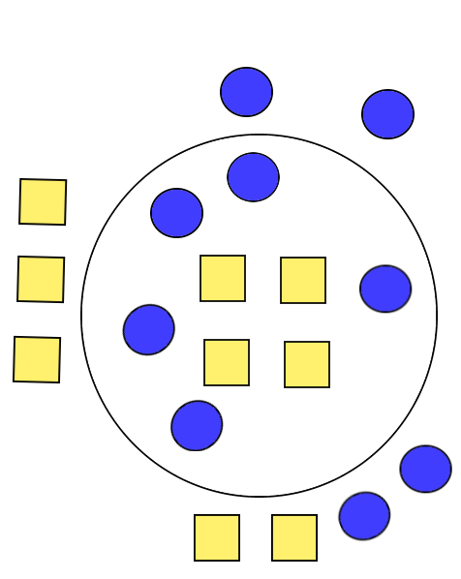
Low Precision

Slide 87
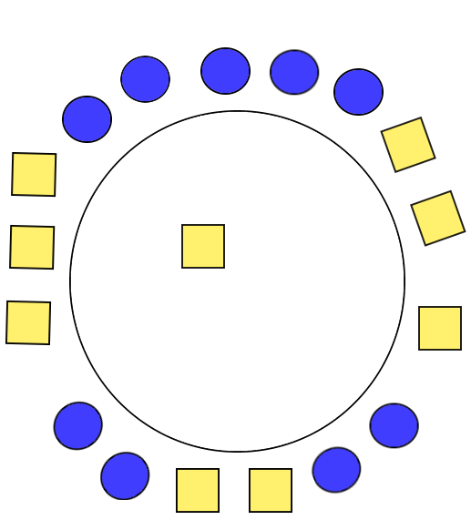
Misleading Precision

Slide 88
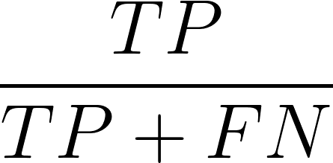
Recall

Slide 89
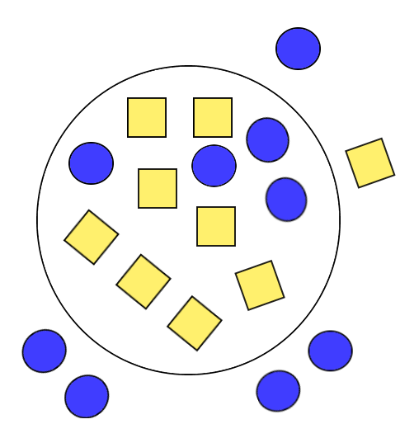
High Recall

Slide 90
Low Recall

Slide 91
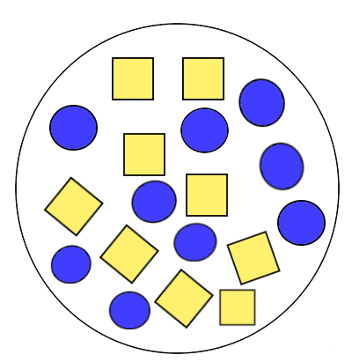
Misleading Recall

Slide 92
Corner Cases

Slide 93
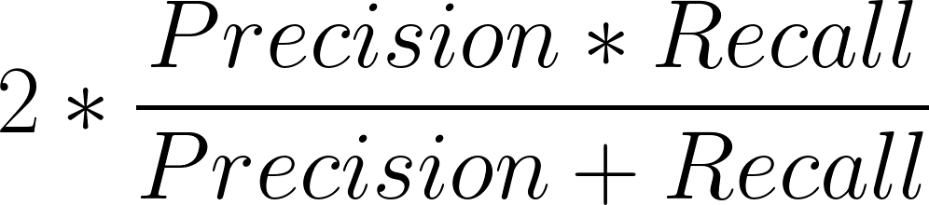
F1 Score

Slide 94
Demo
How to evaluate models with sklearn

Slide 95
Dream of Data Scientist?
Accuracy | Precision | Recall | F1-Score
1 | 1 | 1 | 1

Slide 96


Slide 97
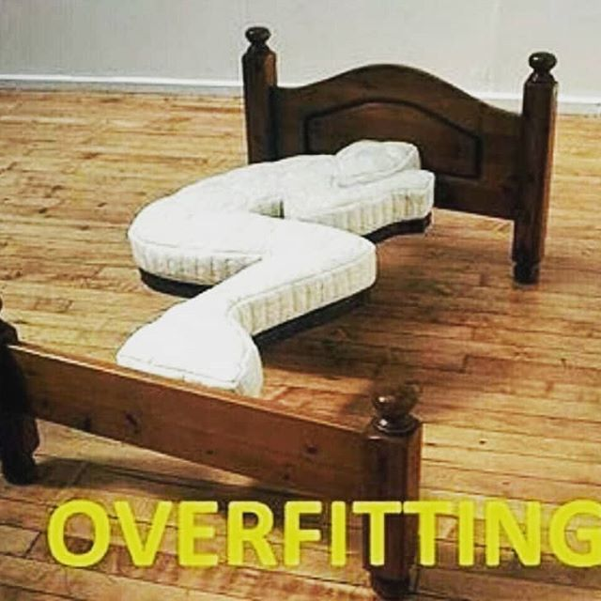

Slide 98
Overfitting
Overfitting happens when a model learns the detail and noise in the training data to the extent that it negatively impacts the performance of the model on new data.

Slide 99
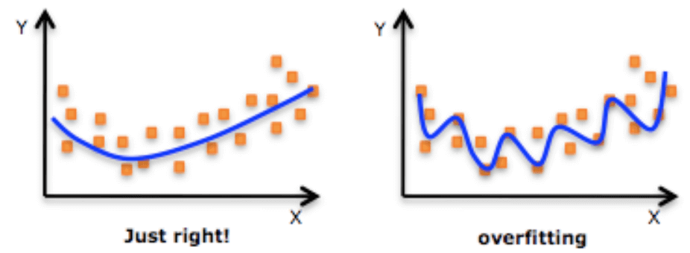

Slide 100
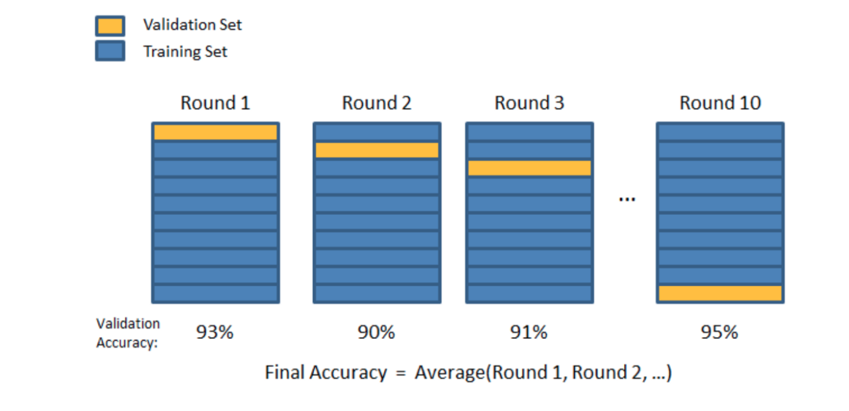
K-Folds Cross Validation

Slide 101
Wellfit Model
k-fold | Accuracy | Precision | Recall | F1-Score
1 | 0.91 | 0.89 | 0.88 | 0.88

Slide 102
Wellfit Model
k-fold | Accuracy | Precision | Recall | F1-Score
1 | 0.91 | 0.89 | 0.88 | 0.88
2 | 0.90 | 0.90 | 0.90 | 0.90

Slide 103
Wellfit Model
k-fold | Accuracy | Precision | Recall | F1-Score
1 | 0.91 | 0.89 | 0.88 | 0.88
2 | 0.90 | 0.90 | 0.90 | 0.90
3 | 0.90 | 0.90 | 0.89 | 0.89

Slide 104
Wellfit Model
k-fold | Accuracy | Precision | Recall | F1-Score
1 | 0.91 | 0.89 | 0.88 | 0.88
2 | 0.90 | 0.90 | 0.90 | 0.90
3 | 0.90 | 0.90 | 0.89 | 0.89
Average | 0.90 | 0.90 | 0.89 | 0.89

Slide 105
Overfit Model
k-fold | Accuracy | Precision | Recall | F1-Score
1 | 0.98 | 0.99 | 0.99 | 0.99

Slide 106
Overfit Model
k-fold | Accuracy | Precision | Recall | F1-Score
1 | 0.98 | 0.99 | 0.99 | 0.99
2 | 0.2 | 0.1 | 0.2 | 0.15

Slide 107
Overfit Model
k-fold | Accuracy | Precision | Recall | F1-Score
1 | 0.98 | 0.99 | 0.99 | 0.99
2 | 0.2 | 0.1 | 0.2 | 0.15
3 | 0.7 | 0.7 | 0.7 | 0.7

Slide 108
Overfit Model
k-fold | Accuracy | Precision | Recall | F1-Score
1 | 0.98 | 0.99 | 0.99 | 0.99
2 | 0.2 | 0.1 | 0.2 | 0.15
3 | 0.7 | 0.7 | 0.7 | 0.7
Average | 0.62 | 0.59 | 0.63 | 0.63

Slide 109
Demo
K-Fold

Slide 110
Underfitting
Underfitting refers to a model that can neither model the training data nor generalize to new data.

Slide 111
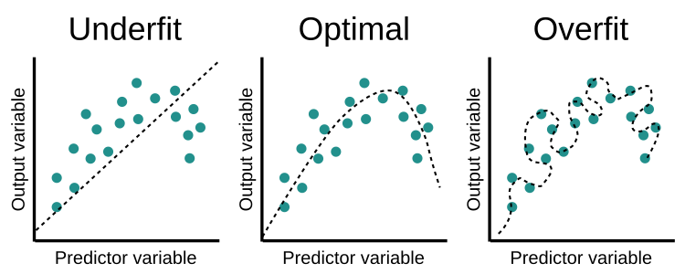

Slide 112


Slide 113
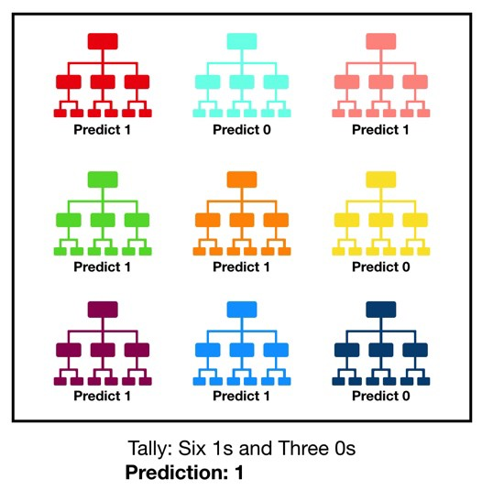
Random Forest

Slide 114
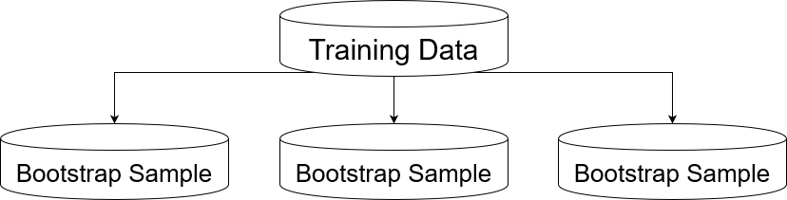

Slide 115
Bootstrap Aggregation (Bagging)
Bootstrapping is the process of generating samples of size B (called bootstrap samples) from an initial dataset of size N by randomly drawing with replacement B observations.

Slide 116
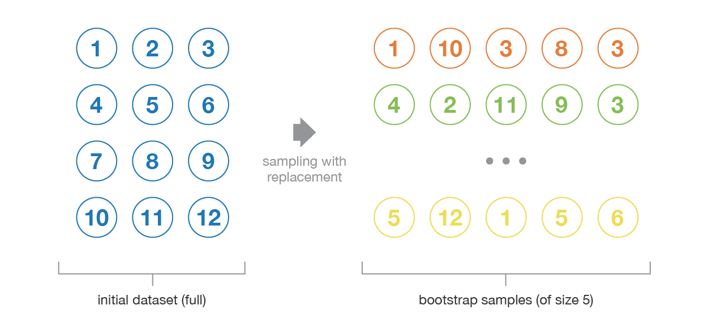

Slide 117
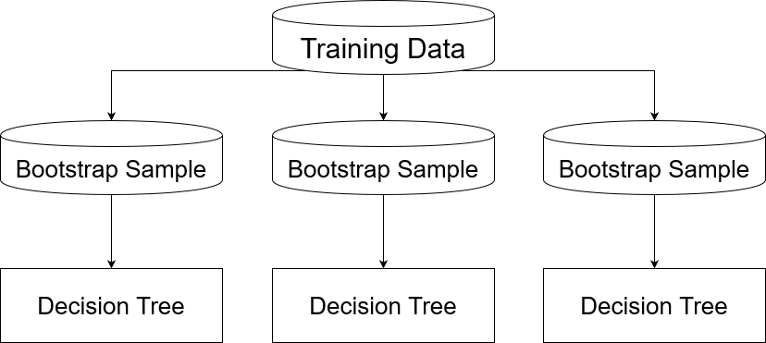

Slide 118

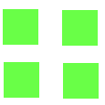
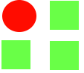
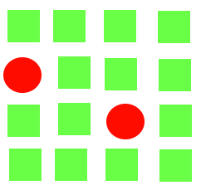
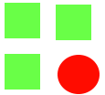

Slide 119
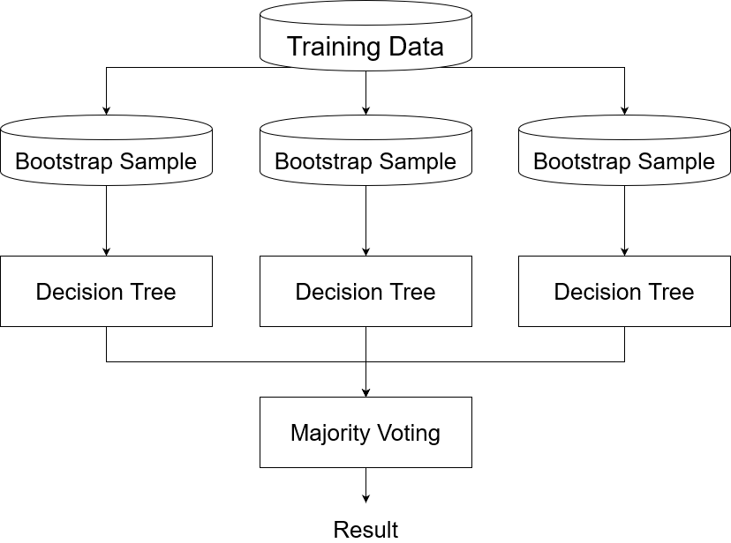

Slide 120
Demo
Random Forest

Slide 121


Slide 122
Feature Importance
Important features for a given model are the features that explain target variable the best.

Slide 123
Permutation Feature Importance
The permutation feature importance is defined to be the decrease in a model score when a single feature value is randomly shuffled. This procedure breaks the relationship between the feature and the target, thus the drop in the model score is indicative of how much the model depends on the feature.

Slide 124
Feature 1 | Test Feature | Feature 2
101 | 111 | 547
204 | 222 | 452
129 | 333 | 679
312 | 444 | 124

Slide 125
Feature 1 | Test Feature | Feature 2
101 | 111 | 547
204 | 222 | 452
129 | 333 | 679
312 | 444 | 124
Feature 1 | Test Feature | Feature 2
101 | 444 | 547
204 | 333 | 452
129 | 111 | 679
312 | 222 | 124

Slide 126
Demo
Permutation importance

Slide 128
Assignments & Next Steps
Hussain NLP Course
Potentially a Internal Kaggle Challenge as Assignment

